Slide 2
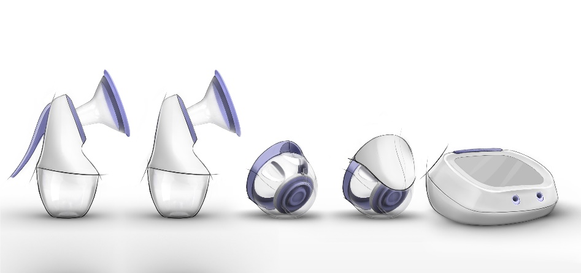
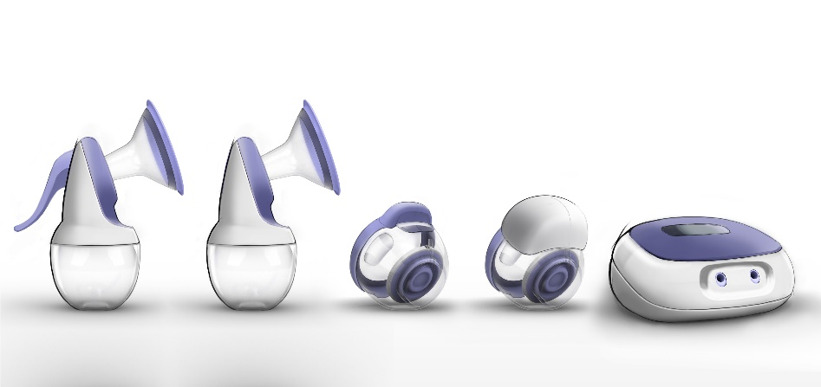
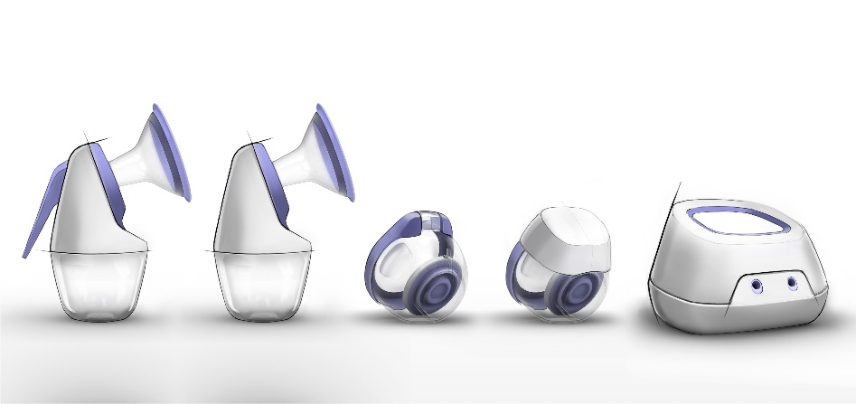
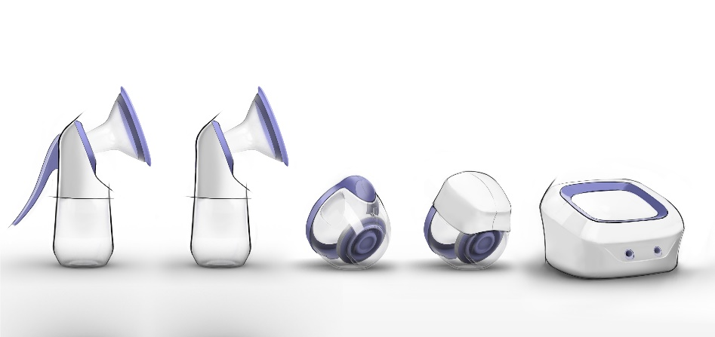
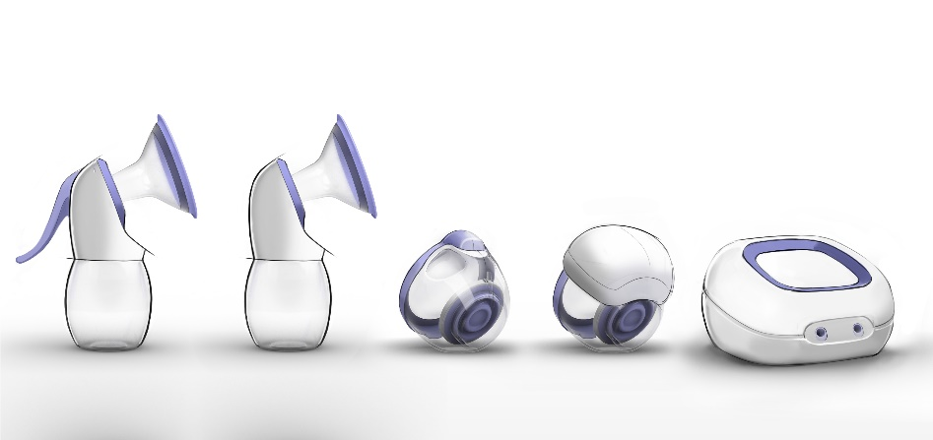
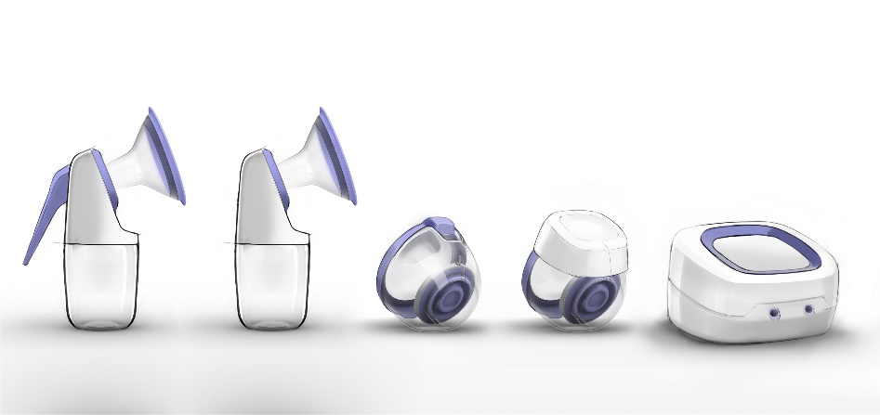
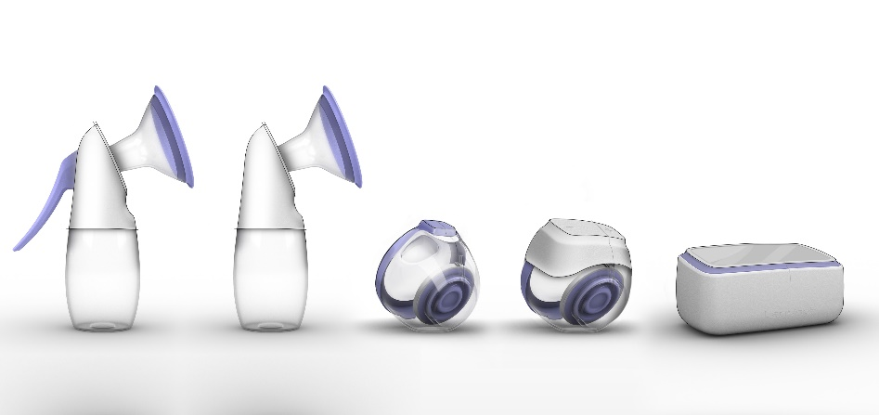
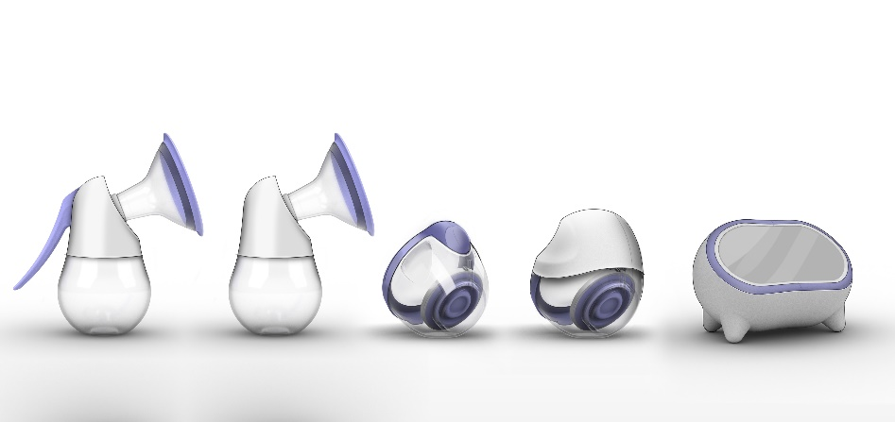
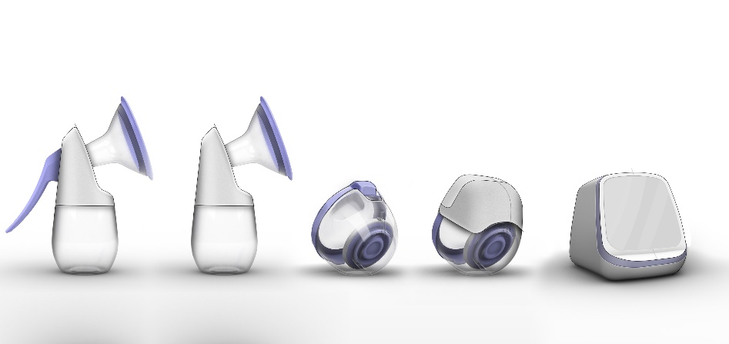
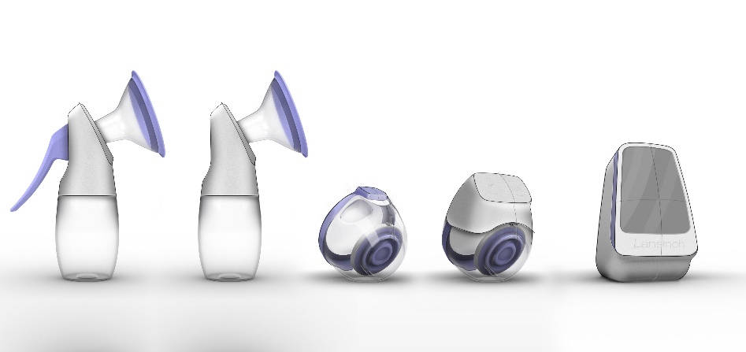
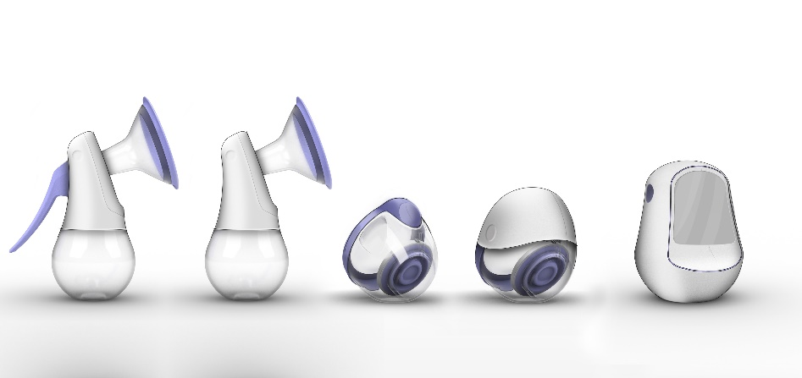
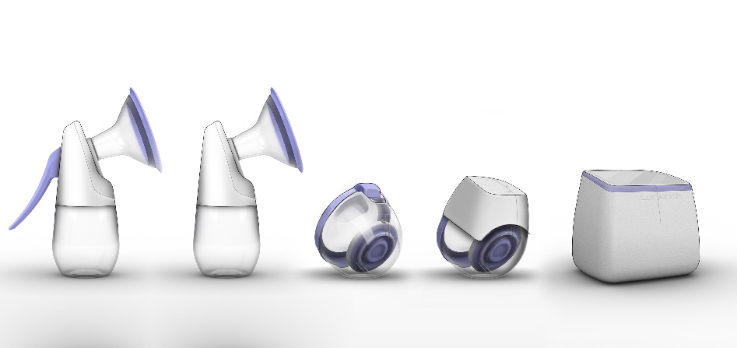
Feminine Refined
Ludic Friendly
Neutral Home

Slide 3
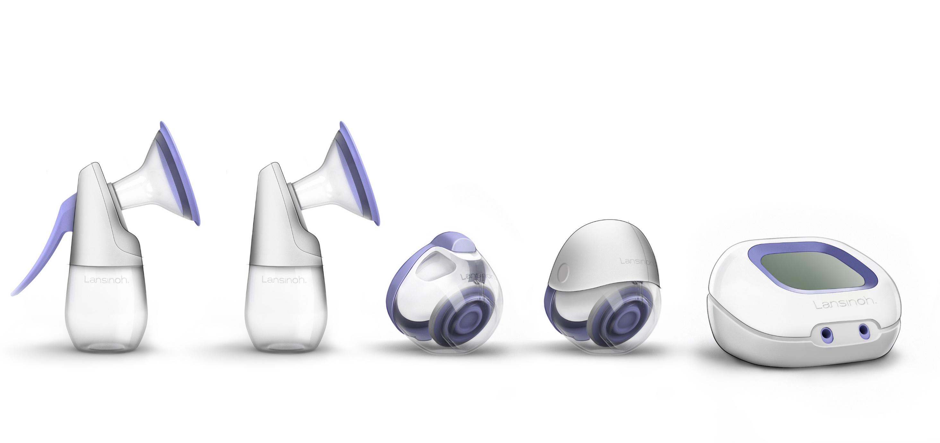

Slide 5
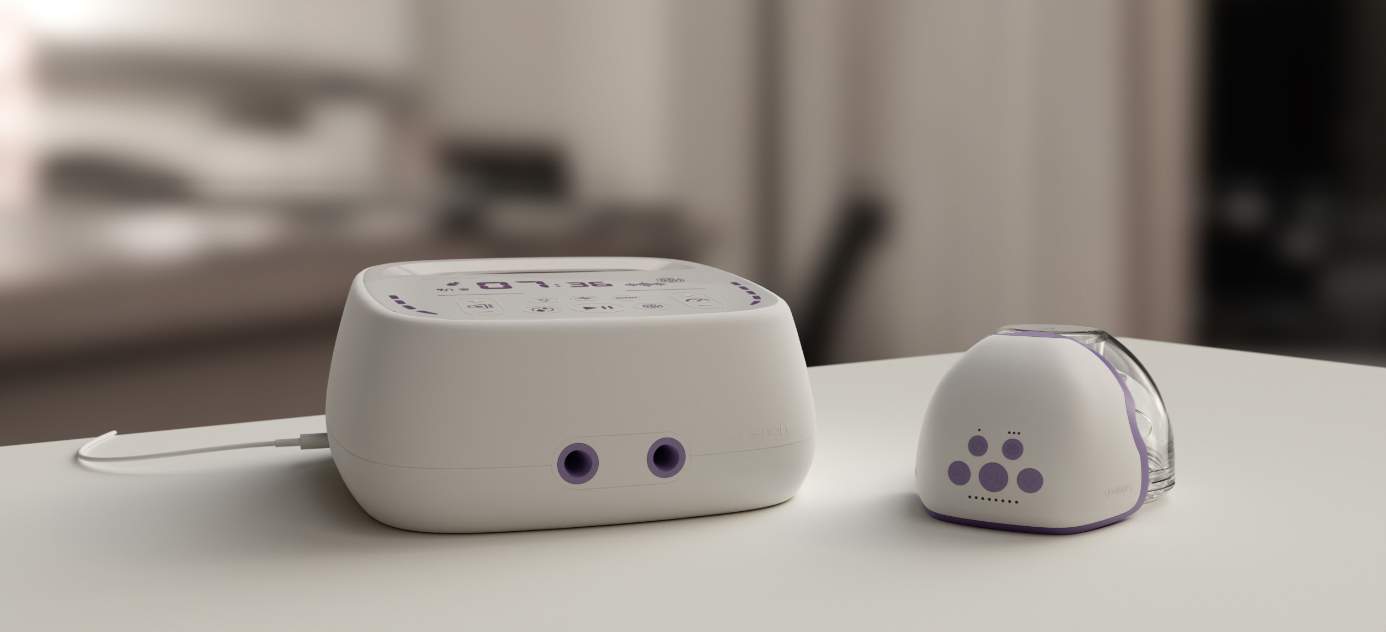

Slide 6
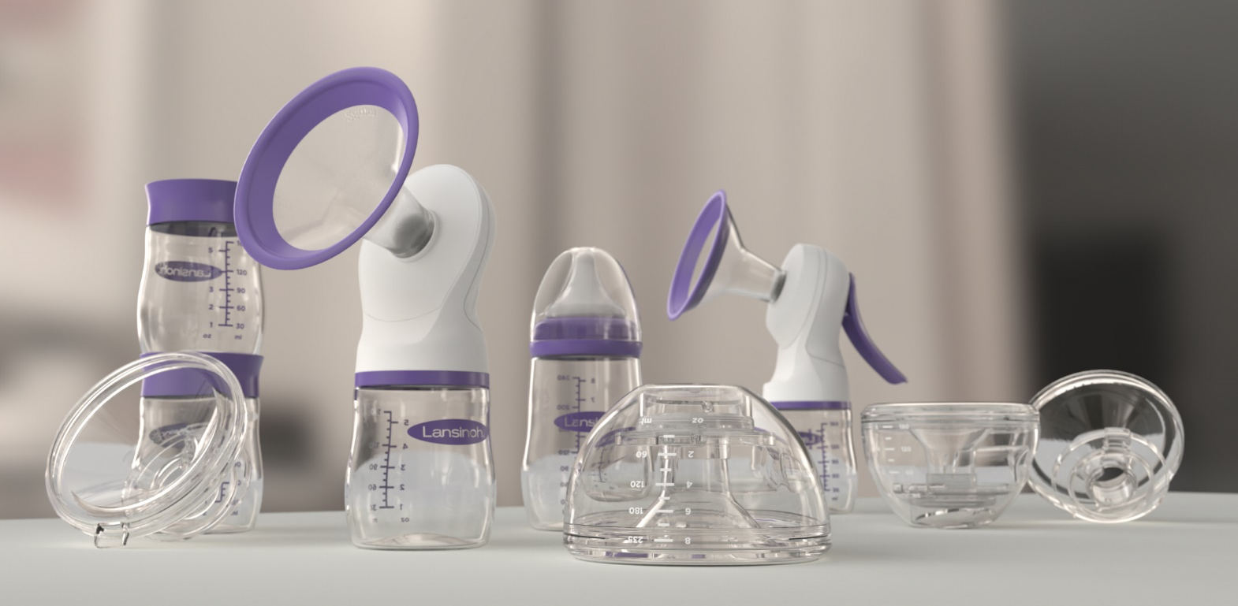

Slide 7
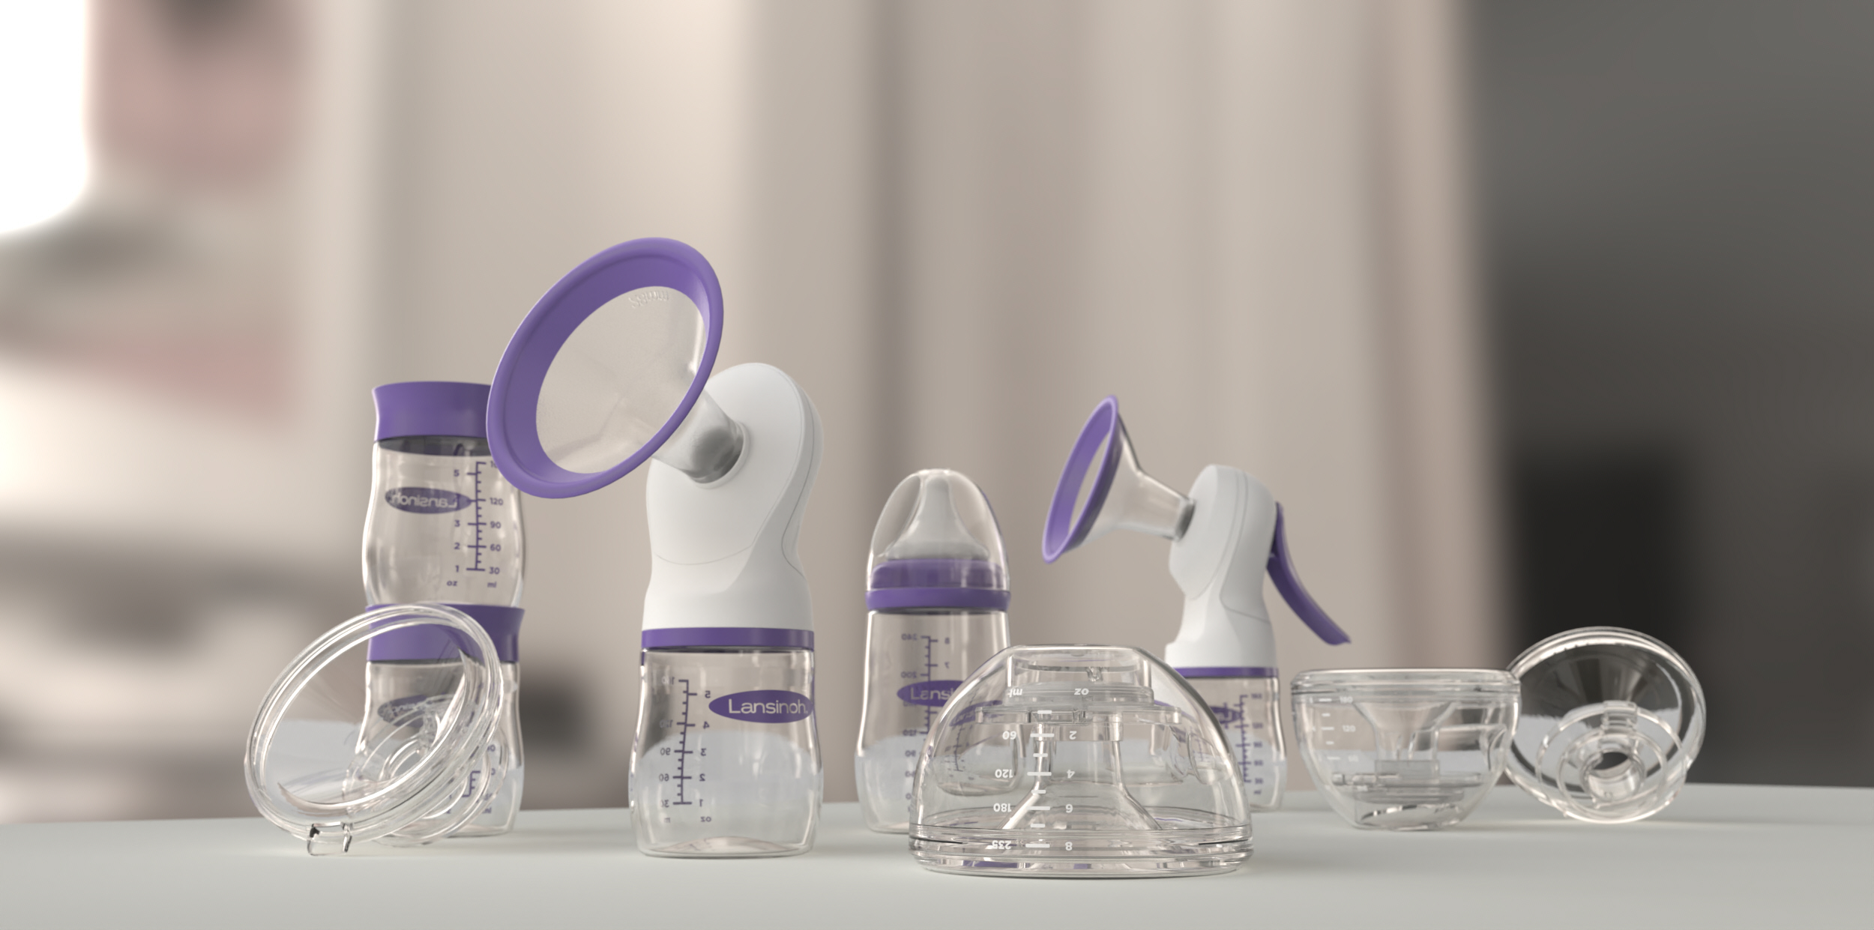

Slide 8
DDI Services Provided to Lansinoh
Mechanical Engineering & Mechanical Design
CAD Design & Detailing
Advanced Structural FEA
DFM/DFA/DFX
Prototypes
Machined
Fabricated
Injection Molded
LSR Molded
3D Printed
Industrial Design
Ideation
Concept Sketches
Renderings
Surfacing
Animations
Electrical Engineering
System Prototyping
Breadboard Design
PCB Design & Prototyping
Firmware Development
Control Strategy Development
Reverse Engineering
Scanning
Inspection
Materials Testing

Slide 9
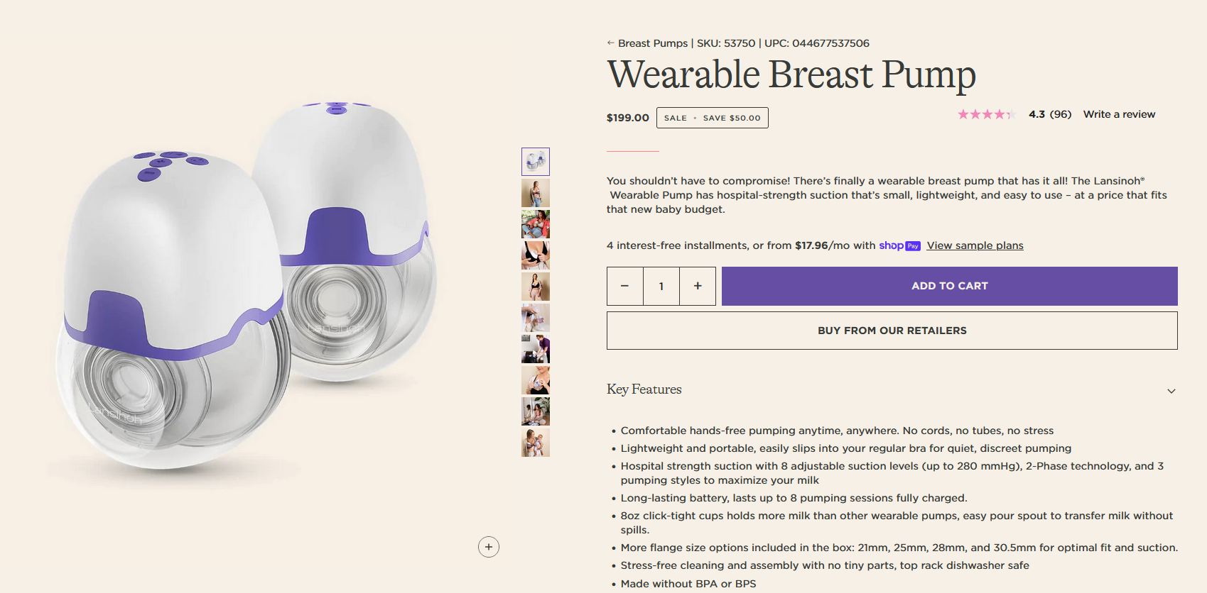

Slide 10
